Slide 1
Personality and Social Psychology Analysis
Exploratory Data Analysis and Insights
Wesley Omoke
6/21/2025

Slide 2
Introduction and Objectives
This dataset contains various social and personality traits of individuals, aiming to distinguish between Introverts and Extroverts.
With that in mind, I aim to:
Explore the data.
Understand feature relationships.
Identify key predictors of personality type.

Slide 3
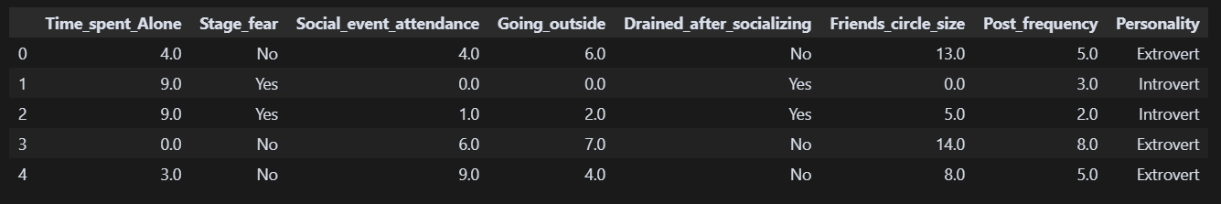
Data Overview
Dataset size: The dataset consists of 2477 rows, and 8 columns after cleaning.
The features represented in the 8 columns are:
Time_spent_Alone (numeric)
Stage_fear (Yes / No)
Social_event_attendance (numeric)
Going_outside (numeric)
Drained_after_socializing (Yes / No)
Friends-circle_size (numeric)
Post_frequency (numeric)
Personality (target :Introvert / Extrovert)

Slide 4
Data Cleaning and Preparation

Slide 5
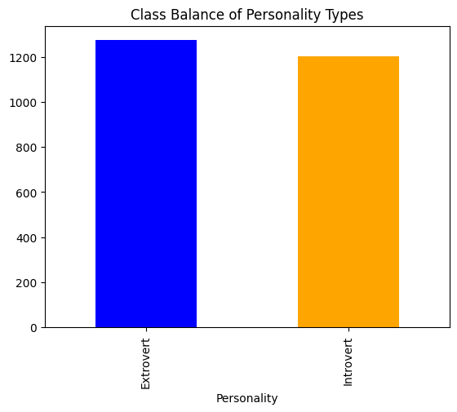
Class Balance
There seems to be a class balance between the proportion of individuals classified as Introverts (48.56%) and Extroverts (51.43%).

Slide 6
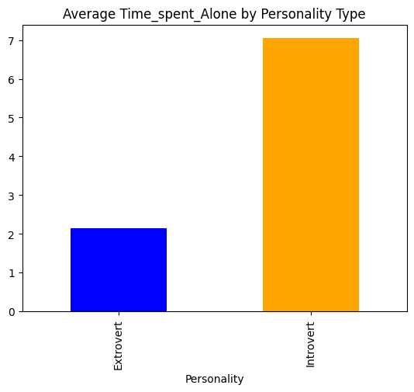
Exploratory Data Analysis
Do Introverts Spend more time alone than extroverts?
Average Time Spent Alone
Introverts – 7 hours
Extroverts – 2 hours

Slide 7
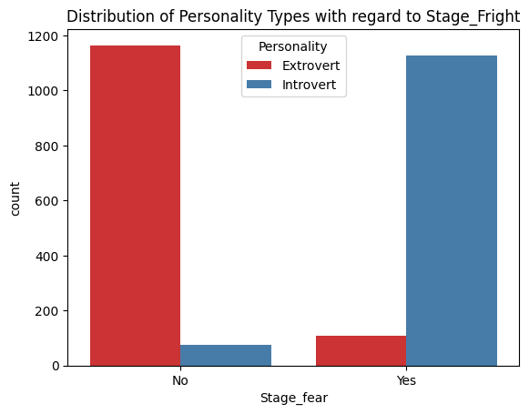
Are Introverts More Likely To Experience Stage-Fright as Compared To Extroverts?
According to our dataset:
Over 93.6% of Introverts are likely to experience stage-fright.
Only 8.5% of Extroverts are likely to experience stage-fright.

Slide 8
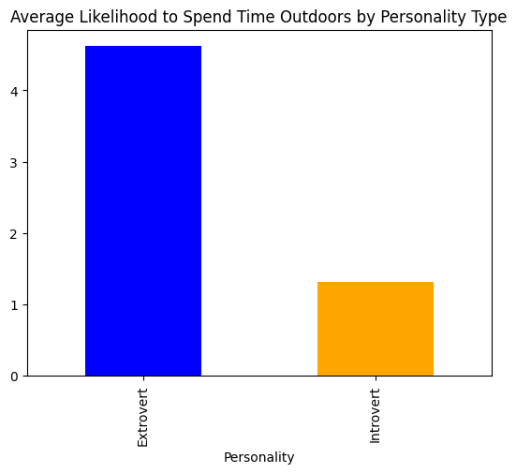
What is the likelihood of each group spending time indoors or outdoors?
According to our data, Extroverts are over 3 times more likely to go outside on average as compared to introverts.
Average Likelihood to Spend Time Outdoors:
Extrovert: 4.62
Introvert: 1.31

Slide 9
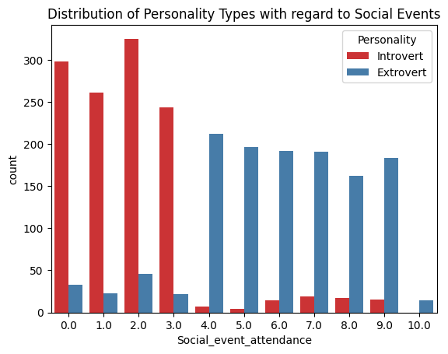
What Is The Average Likelihood For Each Group To Attend Social Events
From the distribution chart, we can see that most introverts indicated that they are unlikely to attend social events and their numbers drop as the scale moves from 0 to 10 while extroverts exhibit the contrary.

Slide 10
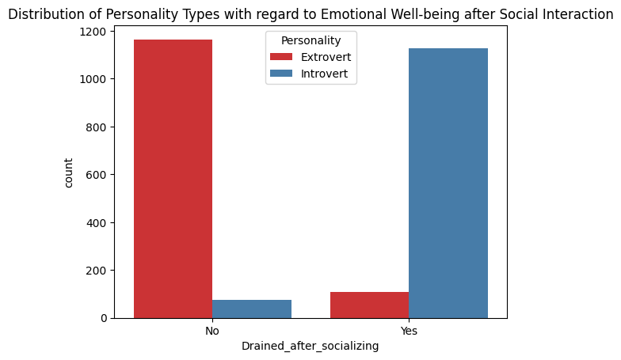
Emotional Well-being After Social Interaction
According to our dataset, Introverts tend to feel more drained after social interaction with over 93.6% of Introverts saying yes and only about 8.5% of extroverts reporting to having felt drained after social interaction.

Slide 11
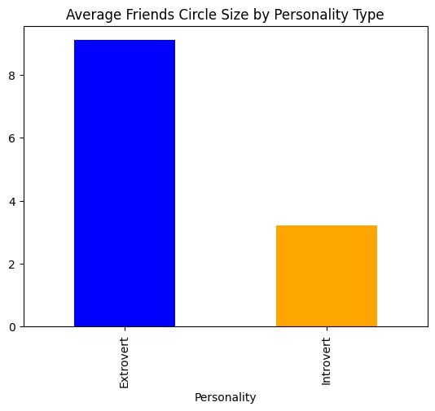
Friends Circle Size
Introverts tend to have around 3 close friends on average, while extroverts could have around 9 close friends.

Slide 12
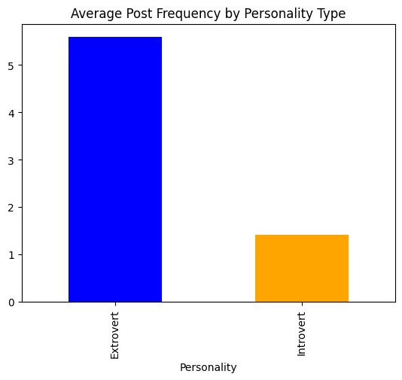
Post Frequency
Introverts are far less likely to post frequently (around 1 time(s) out of 10) on social media as compared to extroverts ( 5 times out of 10).

Slide 13
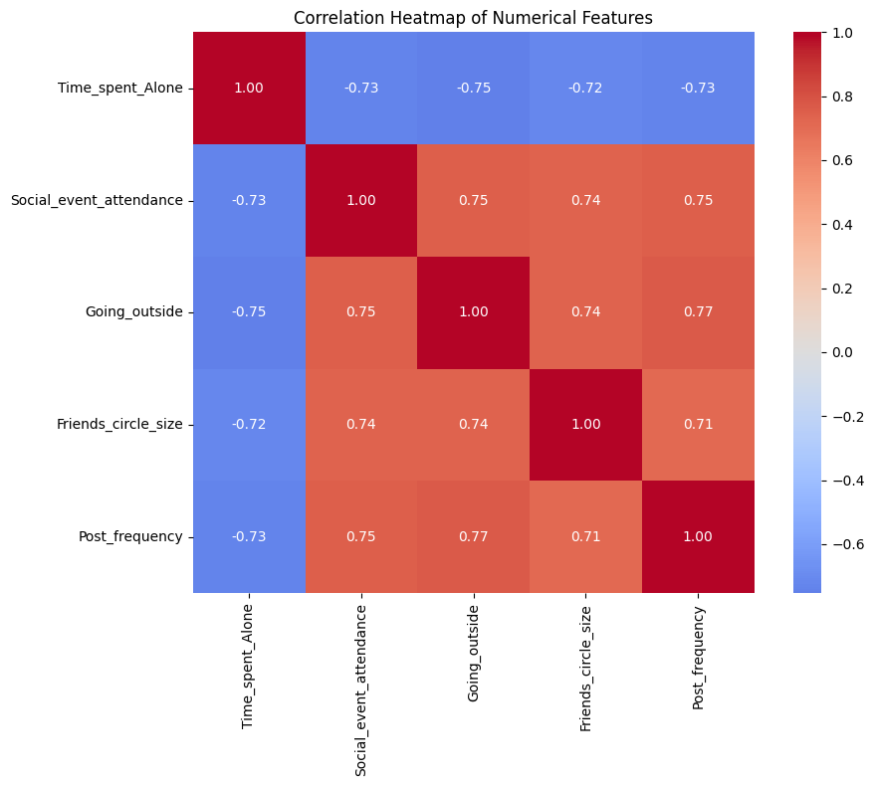
Correlation Analysis
Strongest Positive Correlations (0.7 to 1.0):
Going_outside and Post_frequency (0.77)
This suggests that spend more time outdoors tend to post more on social media.
This makes sense as more outdoor activities might lead to more content to share.
Social_event_attendance and Post_frequency (0.75)
People who attend more social events tend to post more frequently.
This could indicate that social events provide content for social media posts.
Going_outside and Friends_circle_size (0.74)
People with larger friends' circles tend to go outside more.
This suggests that social activities often involve outdoor gatherings.
Social_event_attendance and Friends_circle_size (0.74)
People with larger friends' circles attend more social events.
This is a logical relationship as more friends typically means more social interactions.
Strongest Negative Correlations
Time_spent_Alone and Going_outside (-0.75): People who spend more time alone tend to go outside less. This makes sense as going outside often involves social interaction.
Time_spent_Alone and Social_event_attendance (-0.73):
People who spend more time alone attend fewer social events. This aligns with the introvert/extrovert personality spectrum.
Time_spent_Alone and Post_frequency (-0.73):
People who spend more time alone post less frequently on social media. This suggests that social media activity is related to social engagement.
Implications for Personality Analysis
The strong correlations support the validity of these features for personality classification.
The negative correlations with Time_spent_Alone align with the introvert/extrovert spectrum.
The positive correlations between social activities support the concept of social engagement as a personality trait.
The correlation matrix reveals a clear pattern of social behavior hence the features can be grouped into two main categories:
Social engagement indicators (Going_outside, Social_event_attendance, Friends_circle_size, Post_frequency)
Solitary behavior indicator (Time_spent_Alone)
All social engagement indicators are positively correlated with each other.
Time_spent_Alone is negatively correlated with all social engagement indicators.

Slide 14
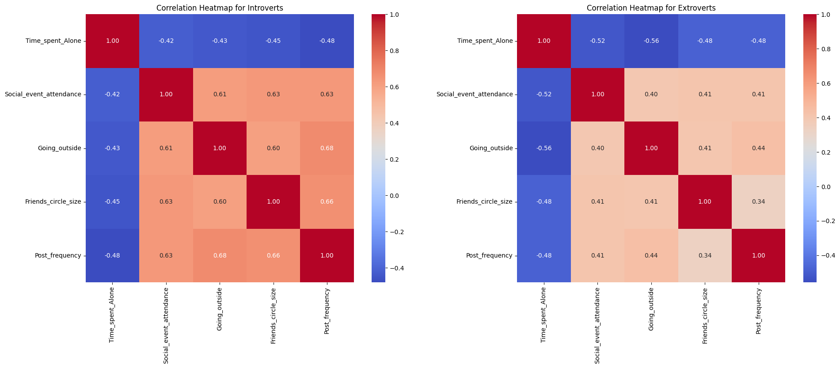
How Do These Correlations Differ Between Introverts and Extroverts?
Notable Differences
The largest difference is in the relationship between Going_outside and Social_event_attendance:
Introverts: 0.61 correlation
Extroverts: 0.40 correlation
Difference: -0.22
This suggests that introverts' outdoor activities are more closely tied to social events.
Implications
Introverts show more consistent patterns in their social behaviors.
Extroverts show more independent social behaviors.
The relationships between social activities and more pronounced for introverts.
Time spent alone has a more uniform effect on extroverts' social behaviors.
Behavioral Patterns
Introverts tend to have more coordinated social behaviors.
Extroverts show more flexibility in how their social behaviors relate to each other.
This might reflect different social engagement strategies between the two personality types.
Key Differences in Specific Relationships
Social Event Attendance and Other Features
Introverts: Stronger correlation (0.61-0.63)
Extroverts: Weaker correlation (0.39-0.41)
This suggests that for introverts, social event attendance is more closely tied to other social behaviors
Going Outside and Post Frequency
Introverts: 0.68 correlation
Extroverts: 0.44 correlation
This indicates that introverts' social media posting is more strongly related to their outdoor activities.
Friends Circle Size and Social Event Attendance
Introverts: 0.63 correlation
Extroverts: 0.41 correlation
This shows that introverts' social event attendance is more closely tied to their friend circle size.
Time Spent Alone Relationships:
For both groups, Time_spent_Alone has a negative correlation with other features.
The correlations are slightly stronger for extroverts (-0.48 to -0.56)
For introverts, the correlations are slightly weaker (-0.42 to -0.48)
This suggest that the time spent alone has a more consistent impact on extroverts' social behaviors.
Introverts show stronger correlations between social behaviors (0.60-0.68)
Extroverts show weaker correlations between social behaviors (0.33-0.56)
This suggests that introverts' social behaviors are more tightly coupled together.

Slide 15
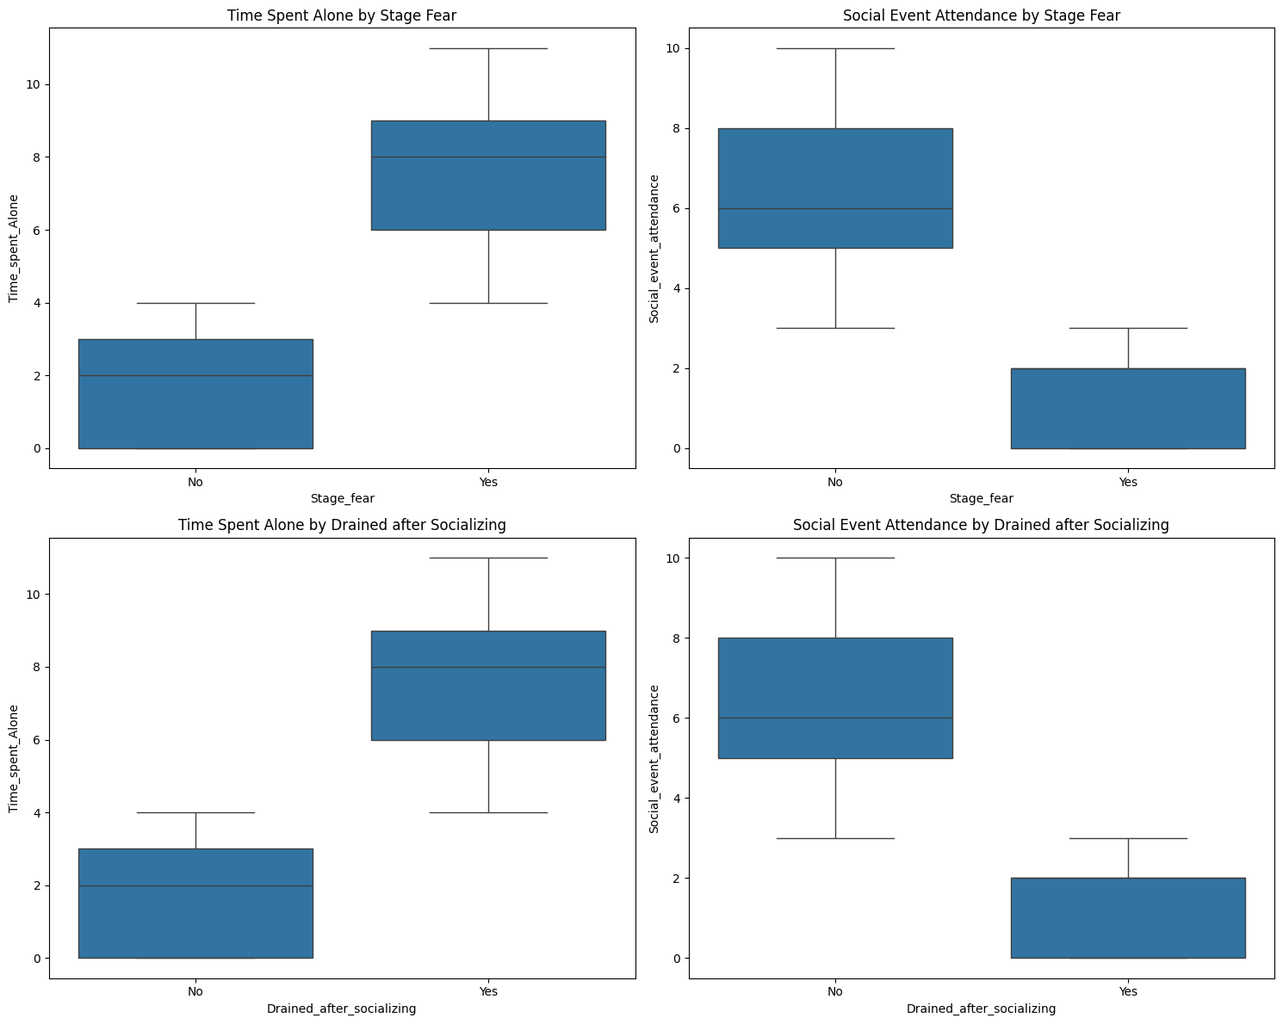
The Relationship Between Categorical Features
Relationship between Stage Fear and Drained After Socializing
Cramer's V = 0.999 (almost perfect association)
This extremely high value suggests these two features are almost perfectly correlated.
This means that people who experience stage fear are almost always the same who feel drained after socializing.
This strong relationship suggests these might be measuring the same underlying trait.
Stage Fear Analysis
Cramer's V = 0.85 (shows a very strong association with personality)
Contingency Table shows:
91.4% of Extroverts have No stage fear
93.7% of Introverts have Yes stage fear
This indicates a very strong relationship between stage fear and personality type.
The relationship is almost perfect, suggesting stage fear is a very reliable indicator of personality type.
Key Insights
Both categorical features are excellent predictors of personality type.
The features are highly consistent with each other.
The patterns are very clear and strong.
There's almost no overlap between personality types in these behaviors.
Drained After Socializing Analysis
Cramer's V= 0.85 (very strong association with personality)
Contingency Table shows:
91.4% of Extroverts Do NOT feel drained after socializing.
93.7% of Introverts DO feel drained after socializing
This shows an equally strong relationship between feeling drained and personality type.
The pattern is very similar to stage fear, suggesting these are closely related behaviors.
Implications These categorical features are very reliable indicators of personality type.
The strong relationship between the features suggests they might be measuring the same underlying anxiety trait.
The clear separation between personality types makes these features very valuable for classification.

